Slide 1


Angular Applications with ASP.NET Core Putting it together
Rick Strahl
West Wind Technologies
west-wind.com
weblog.west-wind.com
@RickStrahl
Session Materials:
https://github.com/RickStrahl/DI2017-AspNet-Core-Angular

Slide 2








About the Presenter
Rick Strahl
Big Kahuna @ West Wind Technologies
Author and Speaker
Popular Blog: weblog.west-wind.com
ASP.NET Insider and MVP
Tools and Components
@RickStrahl
rstrahl@west-wind.com
weblog.west-wind.com

Slide 3
Angular and ASP.NET Together
doing the dance
Online sample at:
http://albumviewer.west-wind.com

Slide 4
Angular and ASP.NET
Not a Natural Fit
Angular wants to take over the entire client side
ASP.NET Provides its own Web publishing
Dev vs. Production
Running with the Development server
Production running behind a full Web Server / Proxy
Output Options
Separate sites
Single Site

Slide 5
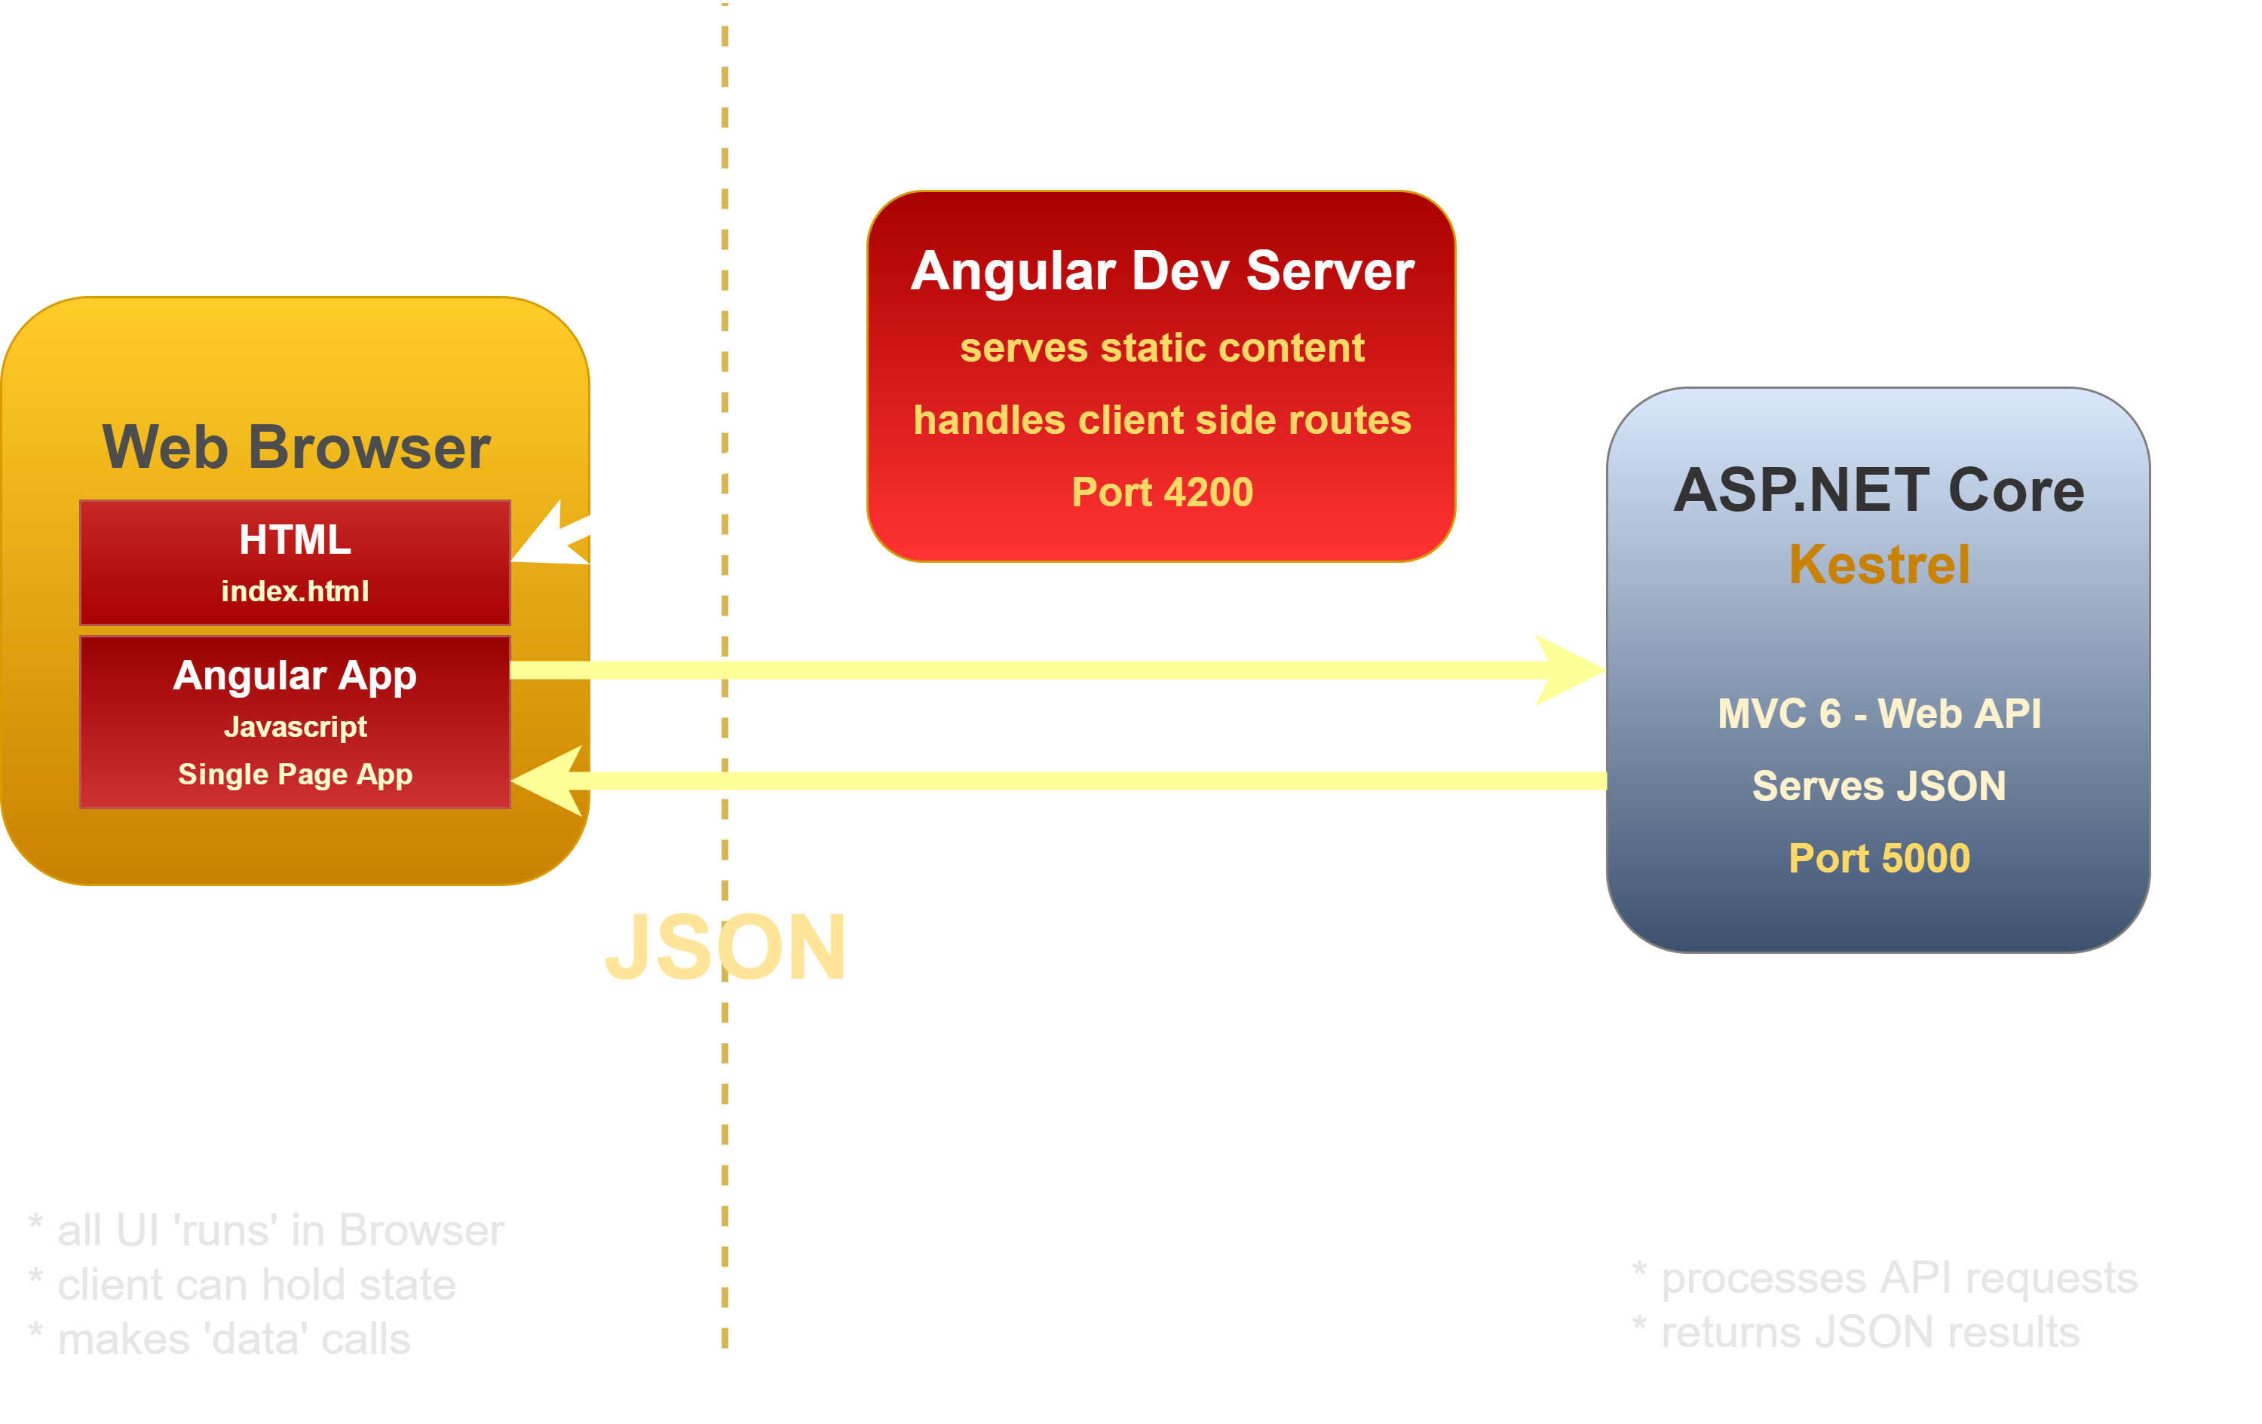


Angular and ASP.NET Core (dev)

Slide 6
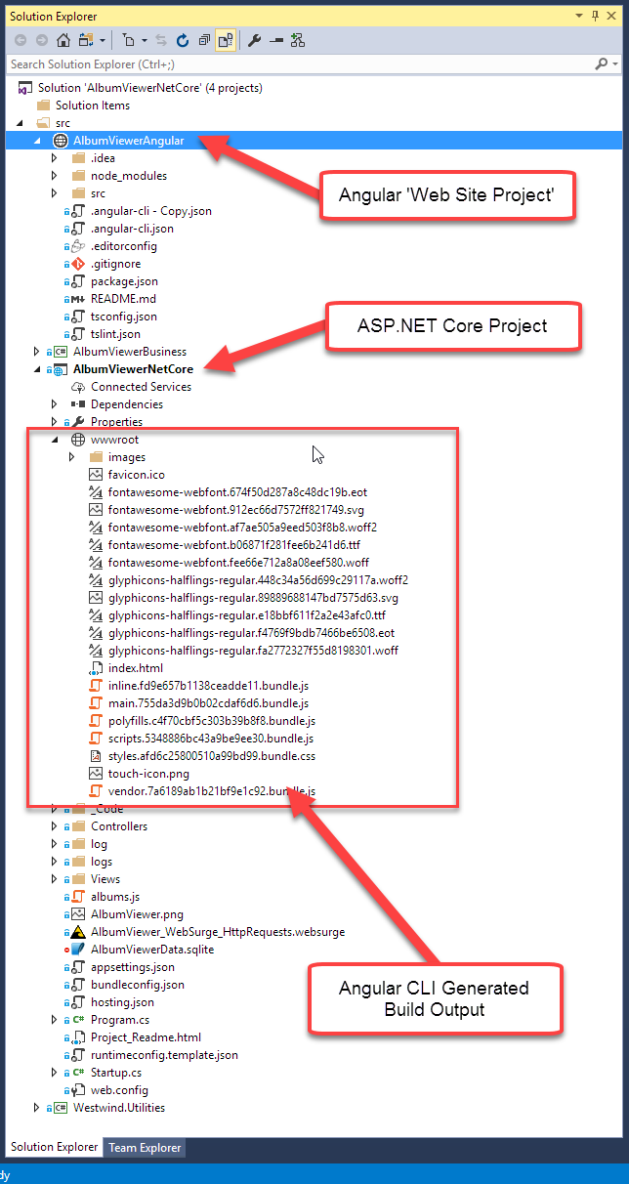
Angular & ASP.NET Core
ASP.NET API Project
Serve JSON data to Angular Front end
Data Access and Business Logic
Use Separate Projects
Core Project for API
Web Site Project for UI
Mark node_modules hidden
Build Angular output to ASP wwwroot
Typical Dev Usage
Angular runs ng-serve dev server
ASP.NET runs Kestrel or IIS Express
Production Usage
Use single site w/ merged wwwroot
Use separate sites/sub-domains

Slide 7
Deployment Approaches
Single Site Output
ASP.NET Core site hosts Angular Application
Need to build Angular CLI output into wwwroot
Pro: Easier to deploy and manage
Pro: Single Site hosting
Con: Angular CLI controls wwwroot (removes during dev, recreates on build)
Separate Sites
Use separate sites for Angular and ASP.NET API
main.site.com and api.site.com
Make sure to enable CORS in ASP.NET
Pro: Same as development process
Pro: Optimized servers for static and API
Con: requires multiple sites

Slide 8
Separation of Concerns
Server Side in .NET
Separate Web API functionality from 'business' rules
Move business logic/repositories into separate project
Break out additional utilities, support libs etc. into projects
Keep it modular
Client Side in Angular
Break out logic into Feature Folders
Break out larger silos into Modules
Reusable/Redistributable components work best with modules.

Slide 9
ASP.NET & .NET Core
ASP.NET
Web API
MVC
Razor Pages
Middleware
ASP.NET Kestrel Web Server
Full .NET CLR
.NET Core CLR
Host
Self-hosted
OS

Slide 10
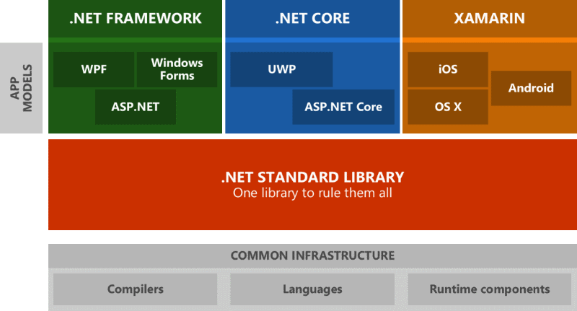
.NET Standard
A Specification Not an Implementation
Minimum required feature set across frameworks
Frameworks have to implement these features
Guaratees consistent .NET base features
If you create libraries – target .NET Standard

Slide 11
.NET Core Web API Considerations
for SPA Applications

Slide 12
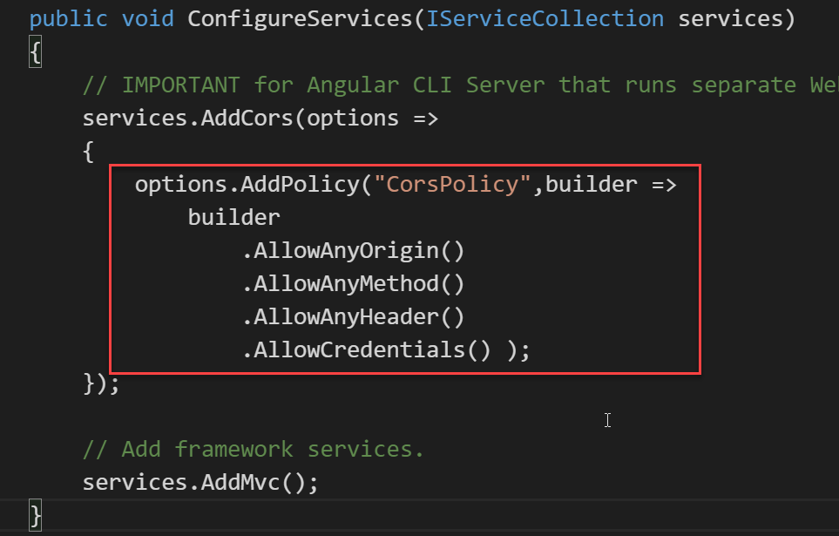
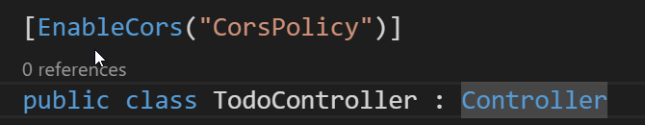

Angular and ASP.NET Core
Configure CORS in ASP.NET Core (Cross Origin Resource Sharing)
Build Output to wwwroot
Send Angular CLI build output to wwwroot
Allows ASP.NET Core App to run full App in Production
or

Slide 13
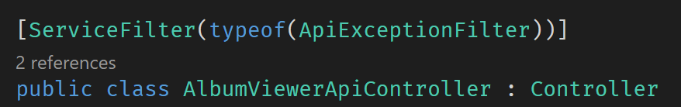
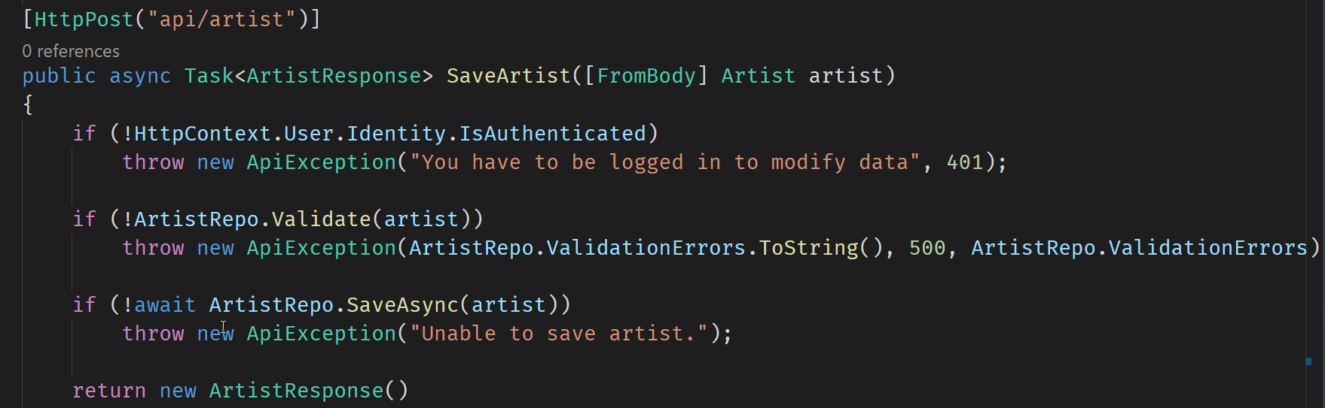
Application Error Handling (server)
Class Declaration
Handle Errors – Throw known Exception

Slide 14
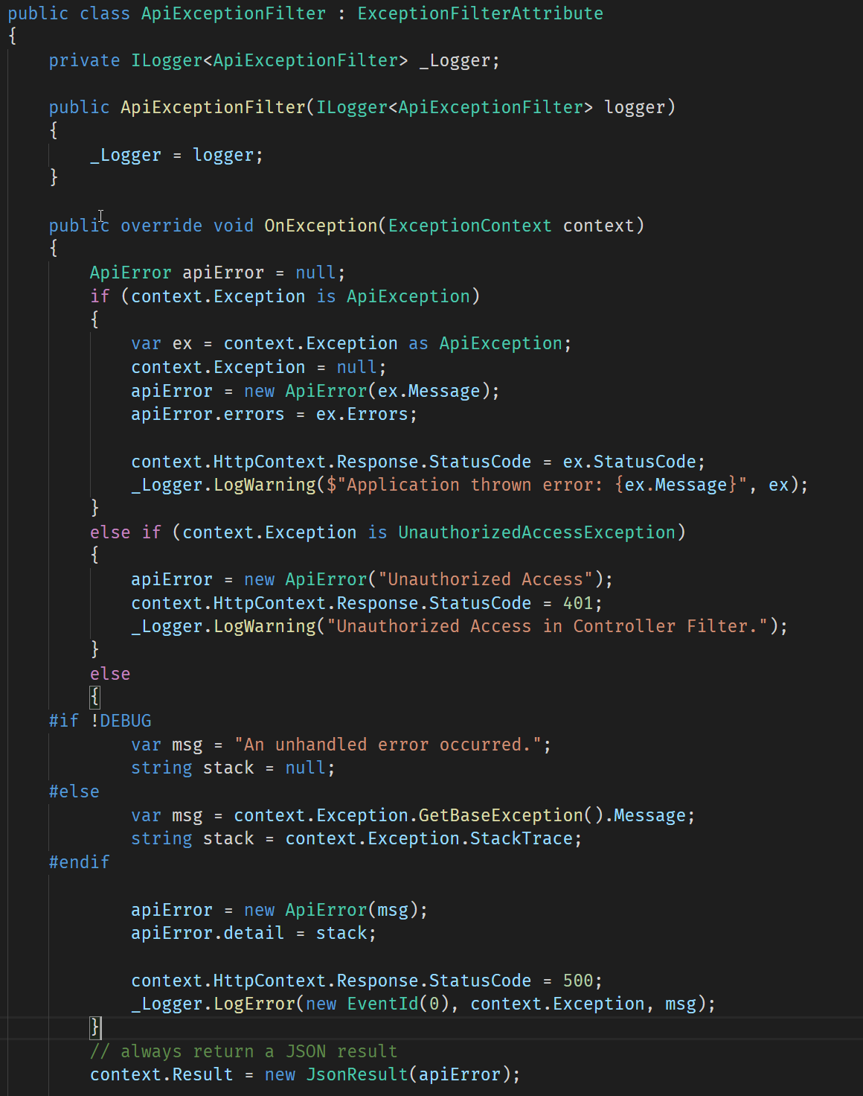
Application Error Handling (server cont.)

Slide 15
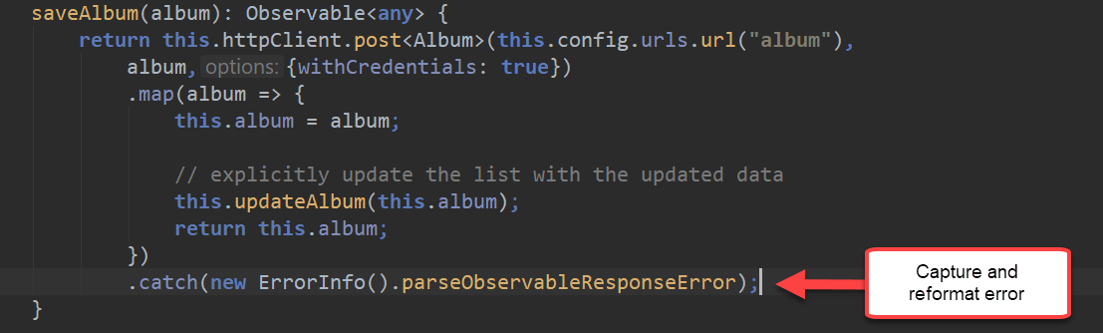
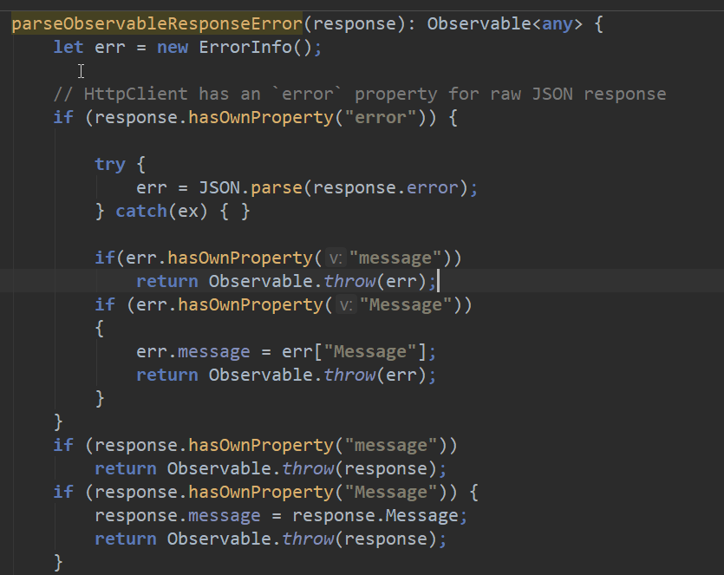
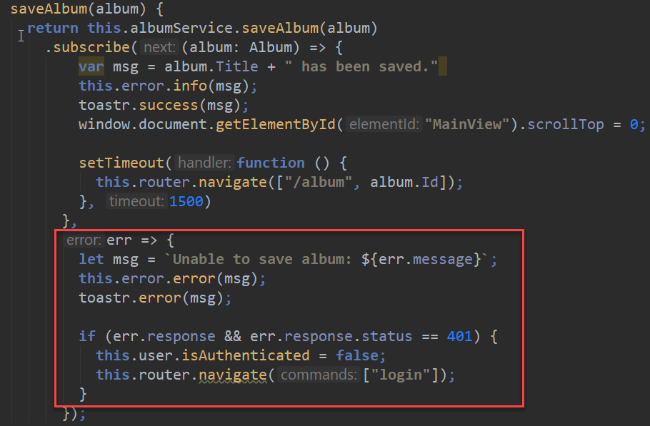
Http Error Handling (client)
Capture and reformat Http Errors
Always return a known Error Object

Slide 16
Server Side Authentication
Complex Identity System
Authentication/Authorization based on ASP.NET Identity
Uses EF to store and manage user accounts
Complex and woefully incomplete
Real world: Use Identity Server for full featured Auth
Identity server provides a full Auth solution
Token Service, user management, login as a service
Includes backend user administration
Simple Authentication is possible in Core
You can implement Simple Cookie/Claims Authentication
Only takes a few lines of code on Server

Slide 17
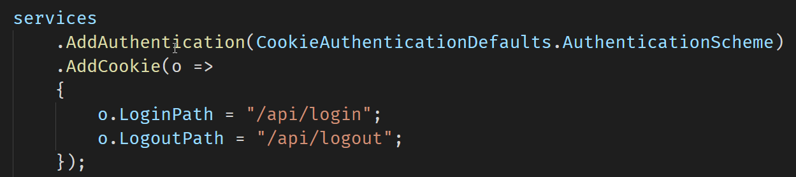
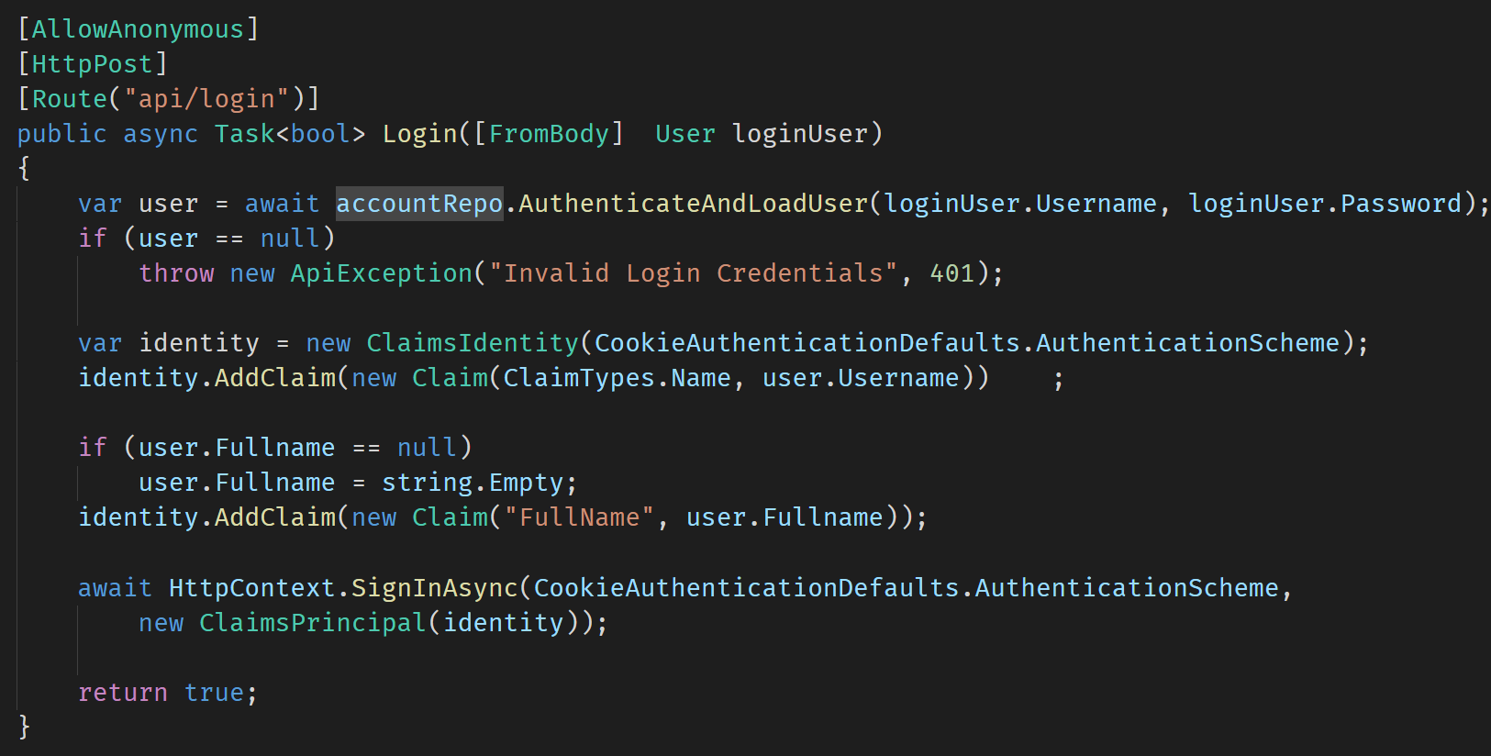
Simple Authentication (server)
Configure Authentication Scheme
Simple Claims based Cookie Signin

Slide 18
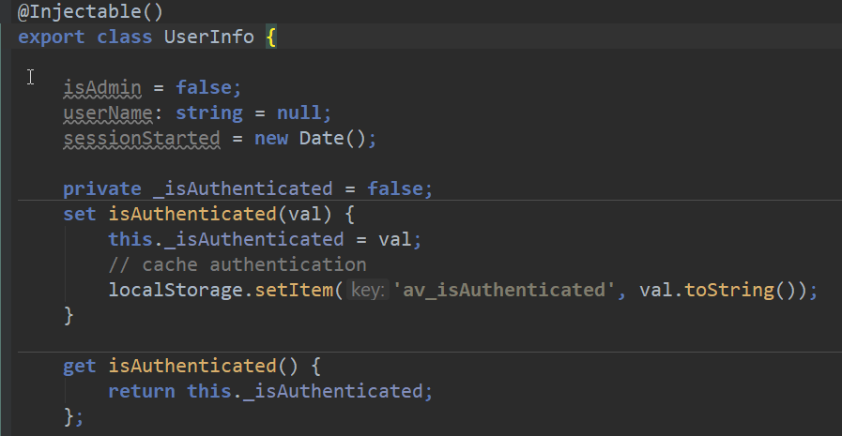
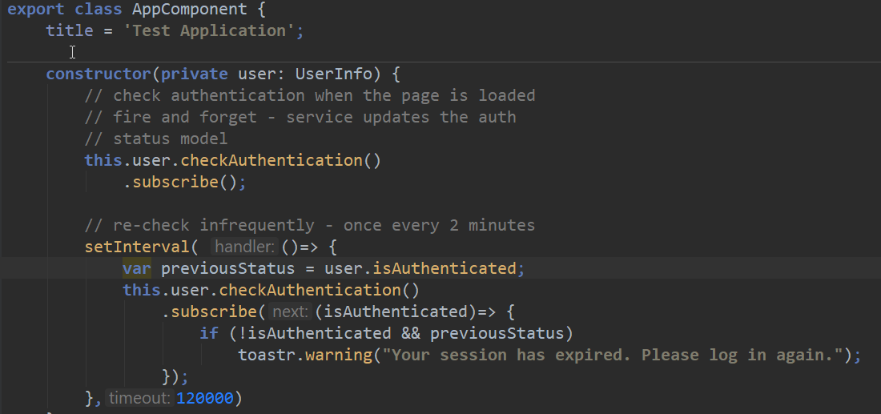
Client Side Authentication
Cache Login Status on Client
Call Login on the Server
On success store status in a service property
Check back for Status
Check at intervals
Verify if user is still logged in
Or: Intercept HTTP request and update
On changed login status show a message
Never trust Client Auth Status
Remember: It's JavaScript
Client can mess with your client code
Always double check authentication on the server!

Slide 19
Deploying to a Web Server
getting an app online

Slide 20
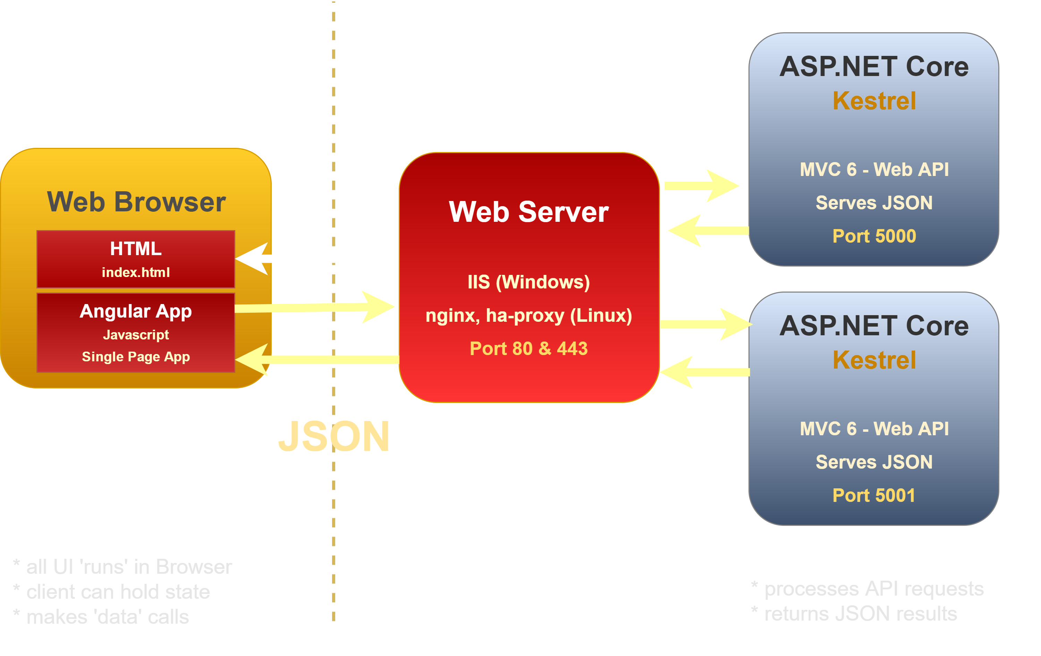


Angular and ASP.NET Core

Slide 21
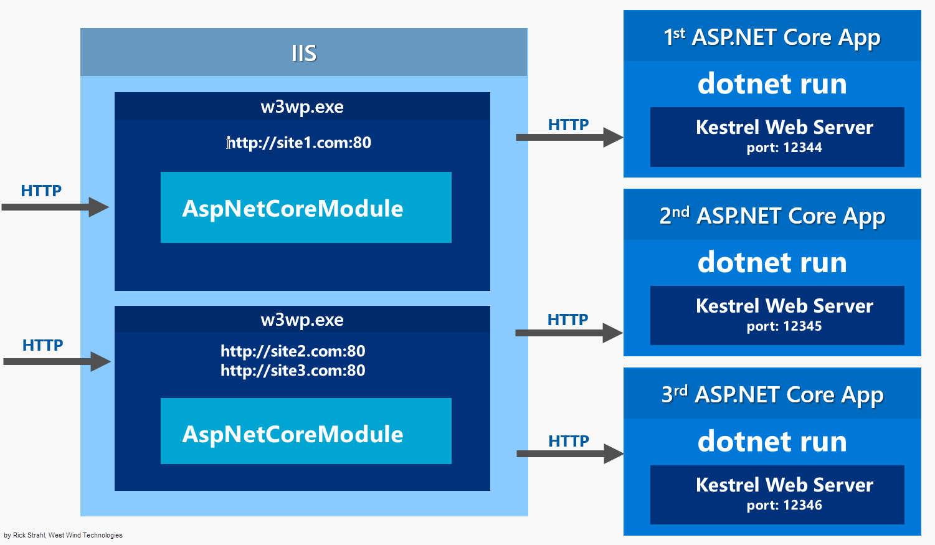
ASP.NET Core on IIS

Slide 22
Let IIS Serve Static Content
AspNetCoreModule
Forwards all requests from IIS to Kestrel
Includes all files – static, and application
Static Content
Kestrel is slow with static content
IIS Kernel Caching is very fast
IIS has built-in Content Compression
IIS – Use IISRewrite
Rewrite static file Url
Rewrite HTML 5 Client Routing
Everything else passed to Kestrel

Slide 23
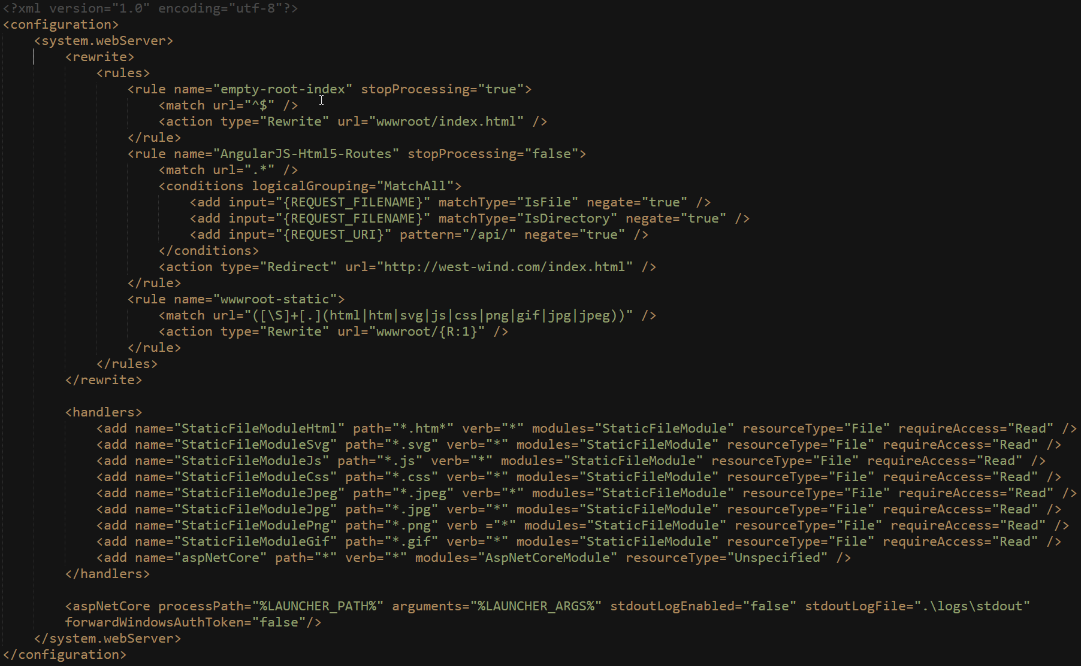
IIS Rewrite Rules for Static Files/HTML 5 Routes

Slide 24
Publishing ASP.NET Core on IIS
ASP.NET Core Apps are published
dotnet publish creates a publish folder
Publish folder is self contained
Your compiled binaries
Support libraries
Optionally can contain entire runtime
Usually references pre-installed runtime
VS Publish and MsDeploy
Existing tools work to deploy to a live Web site
Make sure server has .NET Core Runtimes installed (unless you build with local runtimes)
Make sure server has Windows Server Hosting pack (installs ASP.NET Core Module)

Slide 25
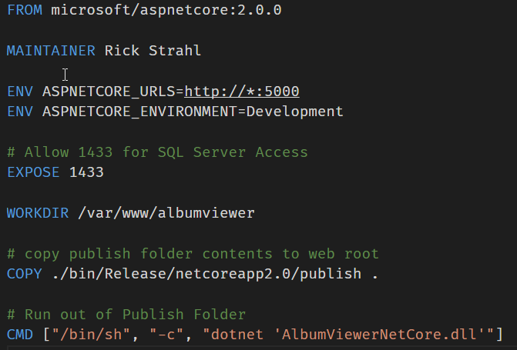
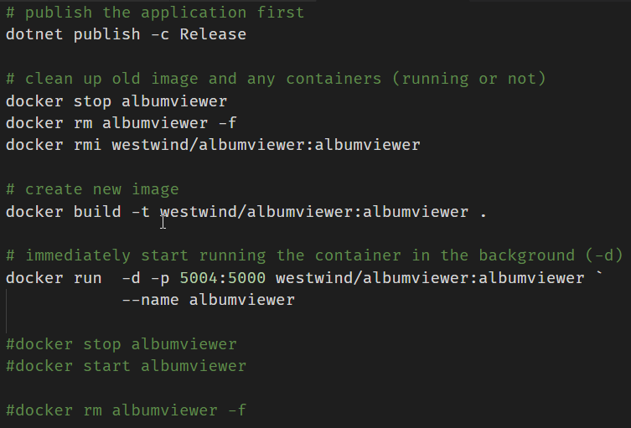
Creating a Docker Image
Build Image from Publish output

Slide 26

Thank you
Github Repo for Samples, Slides, Session Notes
https://github.com/RickStrahl/DI2017-AspNet-Core-Angular
Album Viewer Sample Application
https://github.com/RickStrahl/AlbumViewerVNext
Contact Rick:
weblog.west-wind.com
rstrahl@west-wind.com
west-wind.com/contact
@RickStrahl

